Slide 1
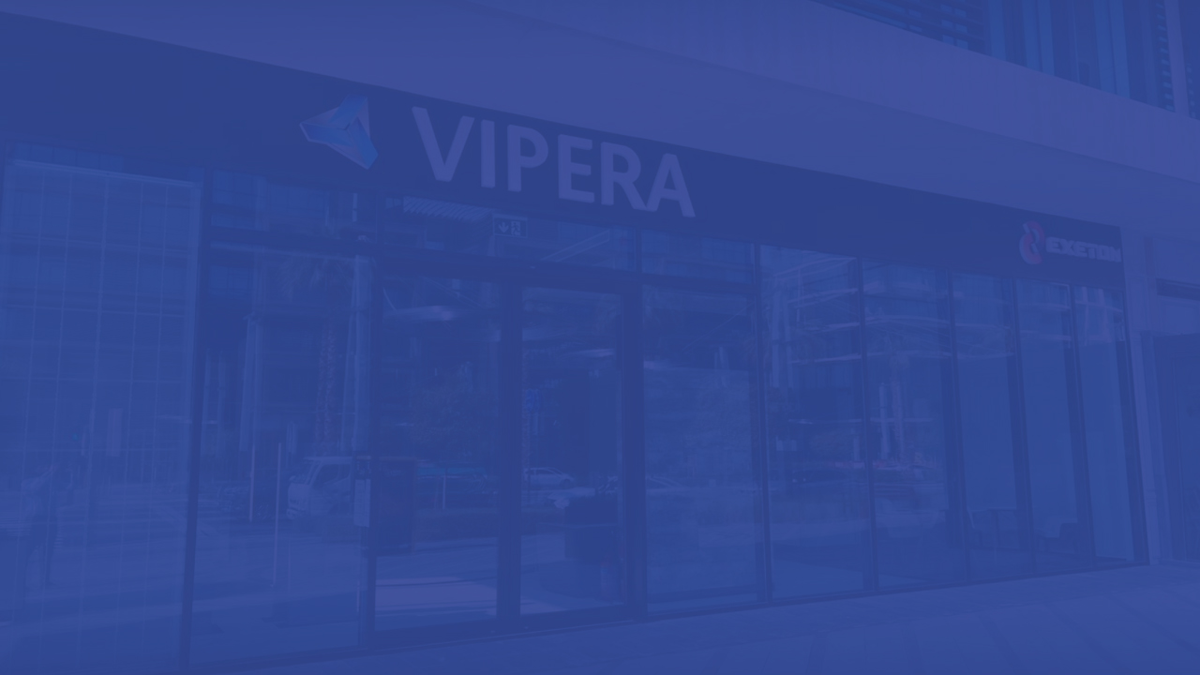

2023 INFOKIT
VIPERA

Slide 2
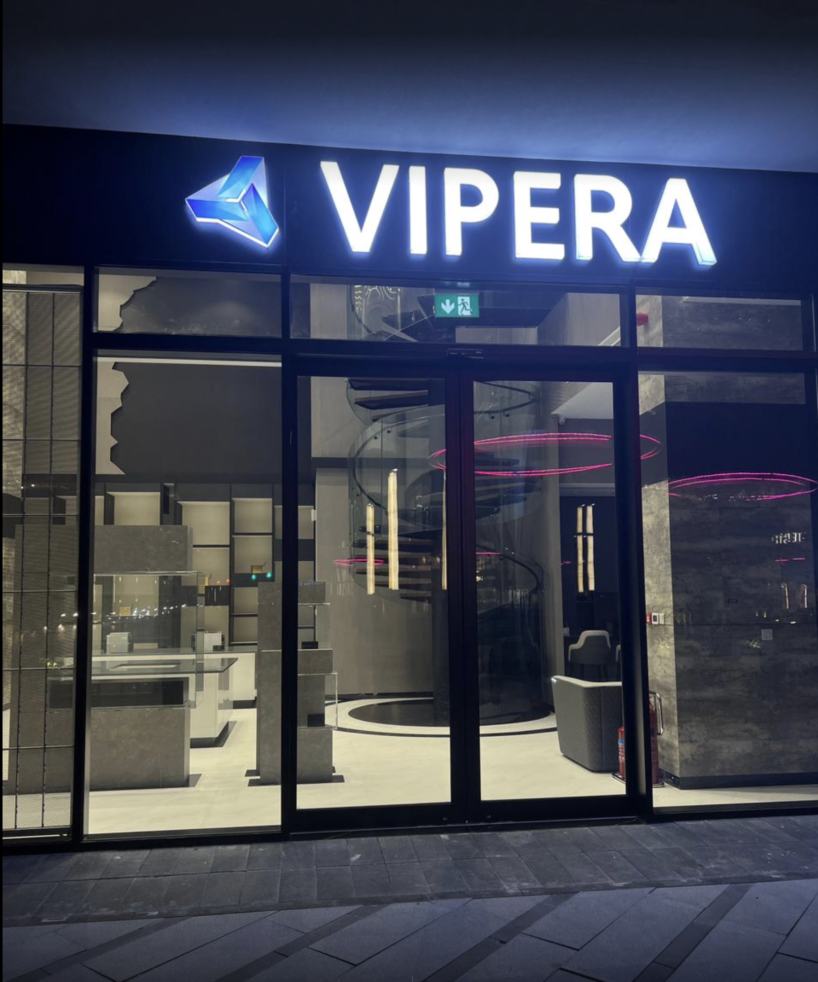
WHO IS VIPERA
Paving the way to future technologies
About Vipera LLC
What We Offer
Crypto
Smart Health
Digital Signage
PC Gaming
AI Computing
Mining Colocation

Slide 3
ABOUT VIPERA
AN INTRODUCTION
What started out as a passion for groundbreaking
technological innovation quickly became a thriving ecosystem of high-end technological and electronic solutions adapted and curated by a team of dedicated specialists leading the way in all things digital.

Slide 4







VIPERA
TOMORROWS TECHNOLOGY TODAY
Vipera is a premier source for selective, highly sought-after electronics and cutting-edge technology solutions catering to the digital advertising, cryptocurrency, A.I. processing, corporate I.T. and PC gaming industries.
PC GAMING
DIGITAL SIGNAGE
SMART HEALTH
AI COMPUTING
CRYPTOCURRENCY
MINING COLOCATION

Slide 5

CRYPTOCURRENCY
– Peter Thiel, co-founder of PayPal
“I do think Bitcoin is the first [encrypted money] that has the potential to do something like change the world.”

Slide 6


Be the Change.
Be a Crypto Pioneer.
SOLUTIONS 2023+
As an authorized reseller of Bitmain, Innosilicon, Canaan and MicroBt we are committed to bringing you state-of-the-art, brand new cryptocurrency mining products that are backed by our extended 2-year and 3-year warranty and 24/7 technical support. These systems are dynamic, purpose-built applications that facilitate incredibly complex computing necessary to create and maintain a cryptocurrency's transaction network. Our ASIC models for Bitcoin and Altcoins such as Ethereum, are known for their power consumption efficiency and return on investment.

Slide 7

Endure the Cycle. Protect your Investment.
OUR DISTINCT ADVANTAGE
CYCLESAFE™ & CYCLESAFE™ Plus are exclusive warranty plans designed for keeping our customer’s ASIC miners risk-free with an extended warranty of 2 or 3 years from date of delivery.
The concept is to ensure every customer has confidence going forward with their substantial investments, and that they remain operational for the majority of their expected lifespans.

Slide 8
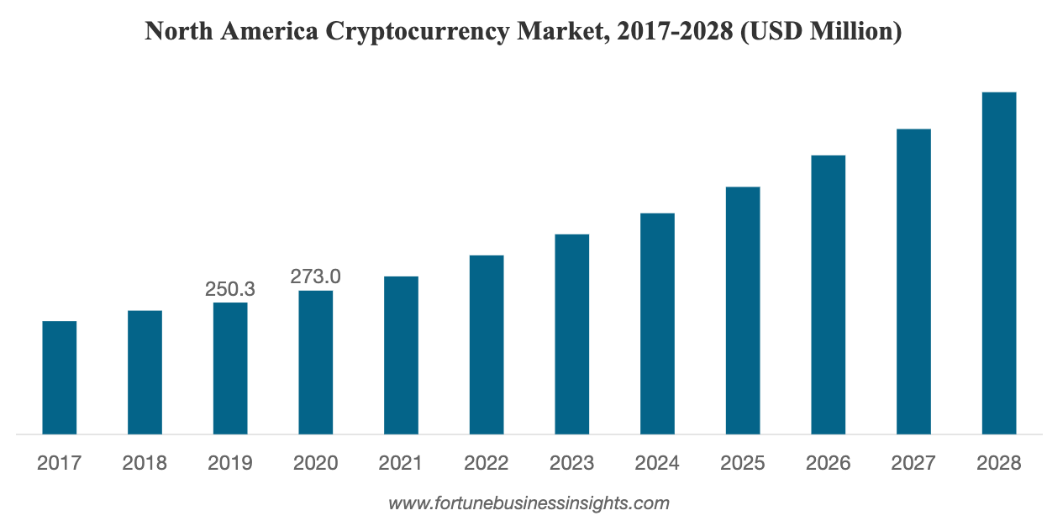
The global cryptocurrency market is projected to grow from $910.3 million in 2021 to $1,902.5 million in 2028 at a CAGR of 11.1% in forecast period, 2021-2028

Slide 9
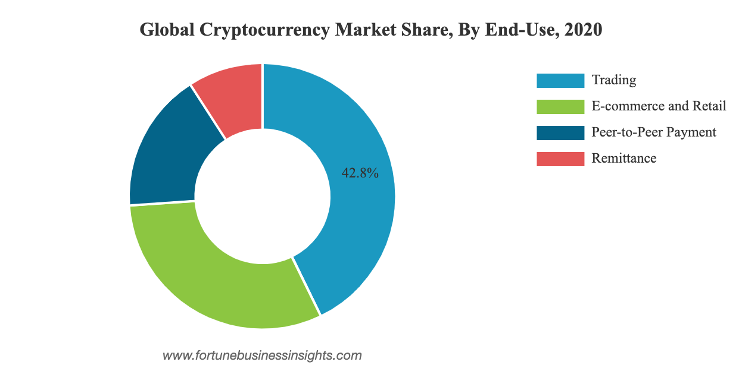
Trading captured the largest market share. The segment focused on crypto solution that are used for trading.

Slide 10
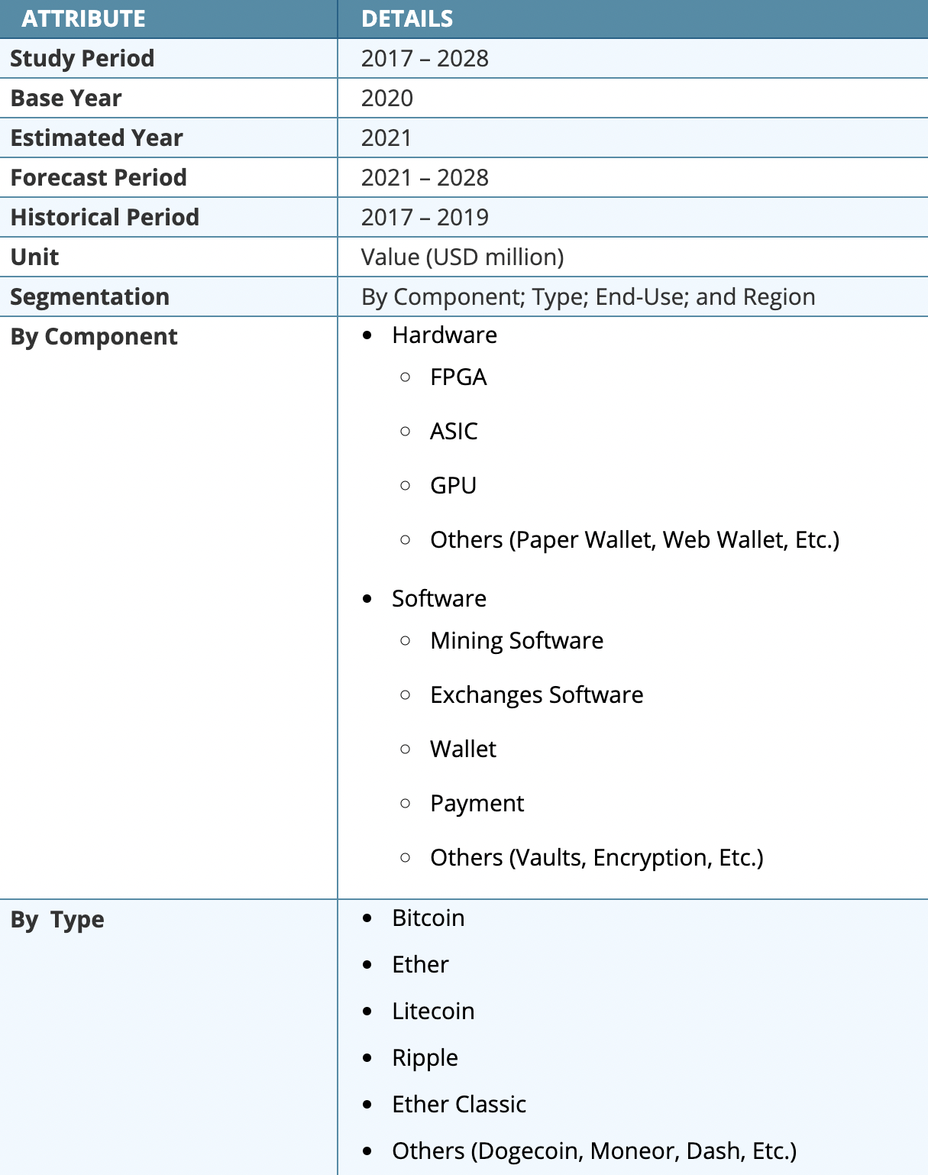
The market research provides an in-depth analysis of the market. It focus on key aspects such as leading companies, product industry and leading mining software and hardware solution.

Slide 11
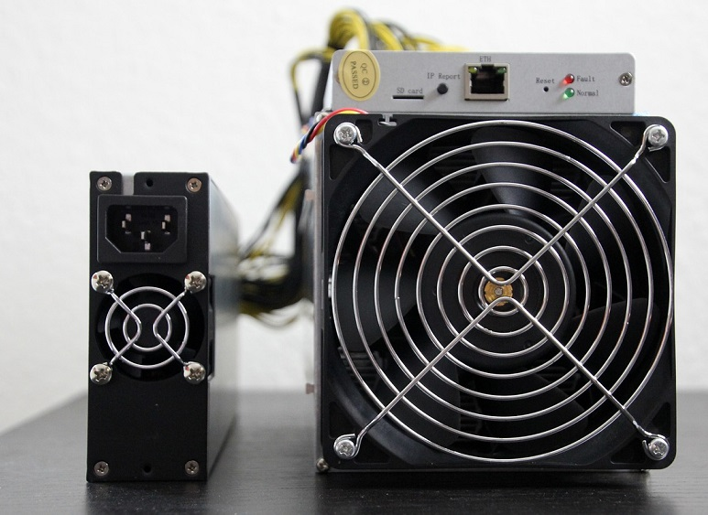
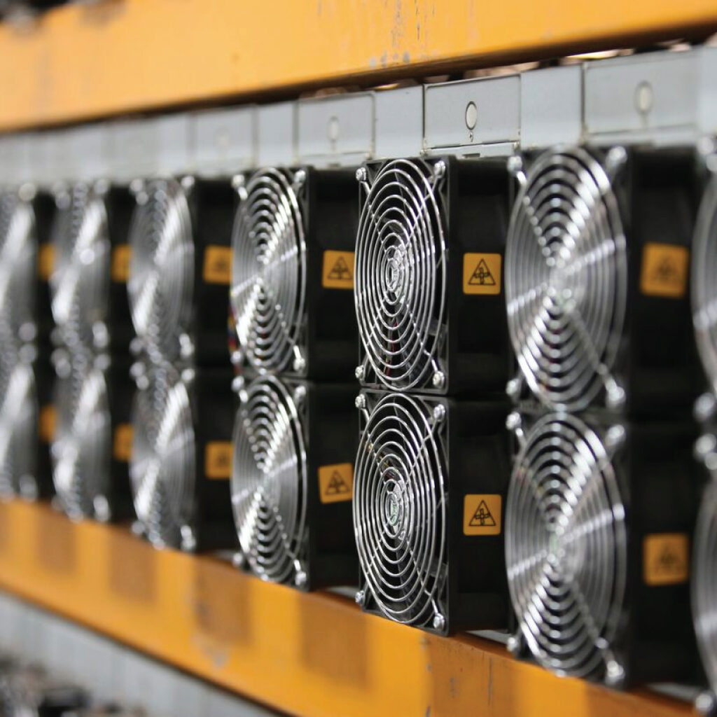
ASIC
Mining

Slide 12
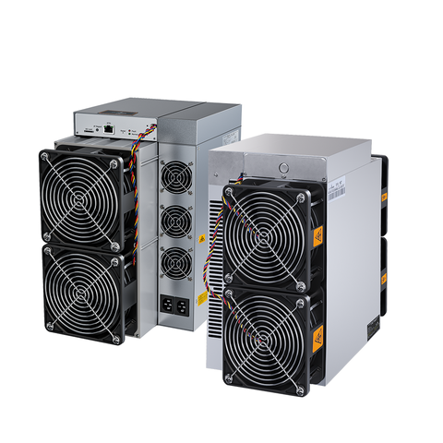
ASIC Mining
Solutions
ASIC miners are at the forefront of the crypto mining industry and are utilized by independent miners and farming operations because of their ability to provide higher hash rates vs energy consumptions and therefor produce more monetary value and reach ROI at a quicker rate than their alternatives.
Our relationships help us source some of the most highly sought-after miners in the market.

Slide 13
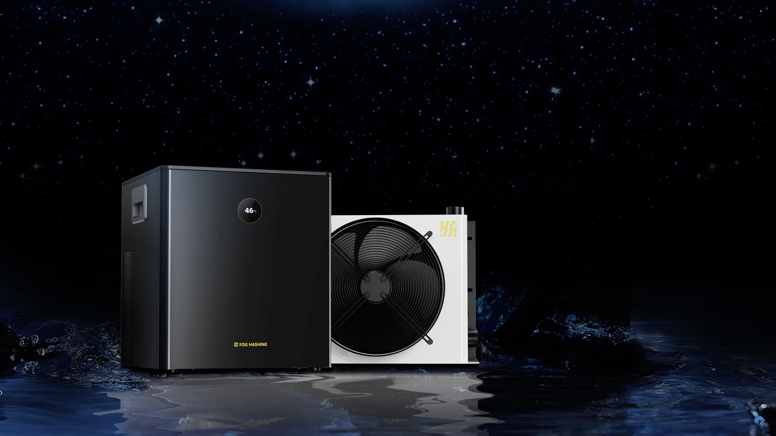
Scaling Solution
For professional small to mid-scale mining operations.
A more efficient and economical solution that allows you to overclock and extract the most hashing performance out of your ASICS.

Slide 14
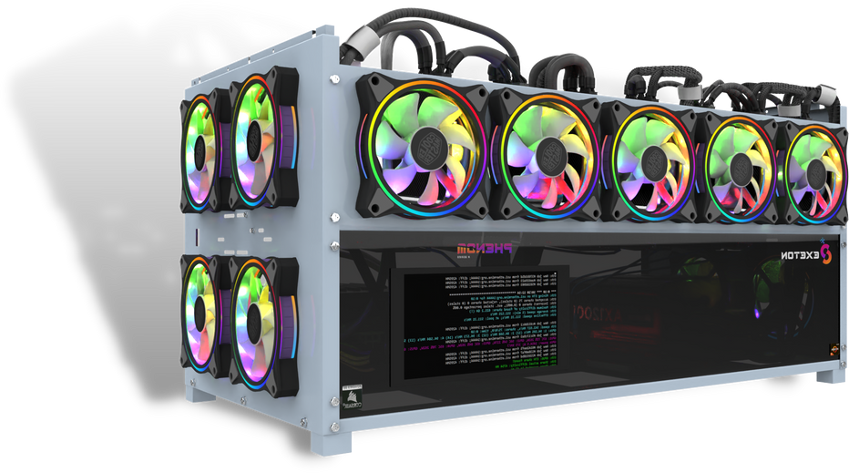
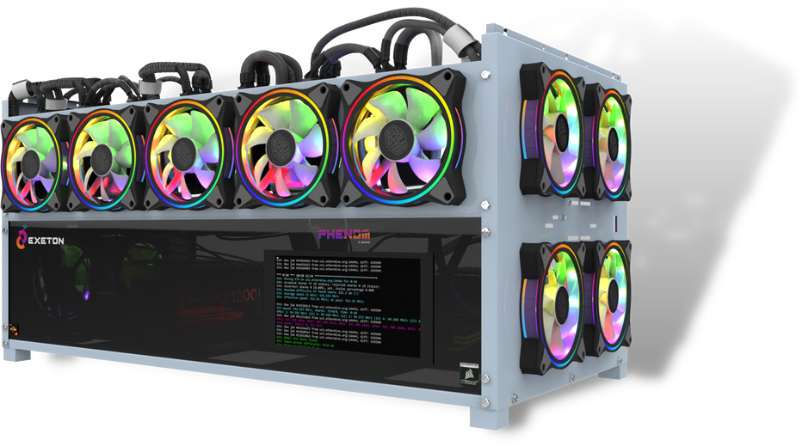
Welcome to the Phenom GPU Rig
One of the fundamental ways GPU mining has been able to stay prolific and continue its success in the mining industry is through the employment of GPU Rigs.
Dedicated housing, custom built to combine multiple GPU's in the same shell to enable improvements in power efficiency and combined hashpower.
At Vipera, we have handbuilt and custom designed the most powerful, high end GPU Rig to date, and we're proud of it. Using years of expertise in the computing field along with our deep understanding of mining we were able to handcraft a Rig that enables the most profitable operation possible.

Slide 15
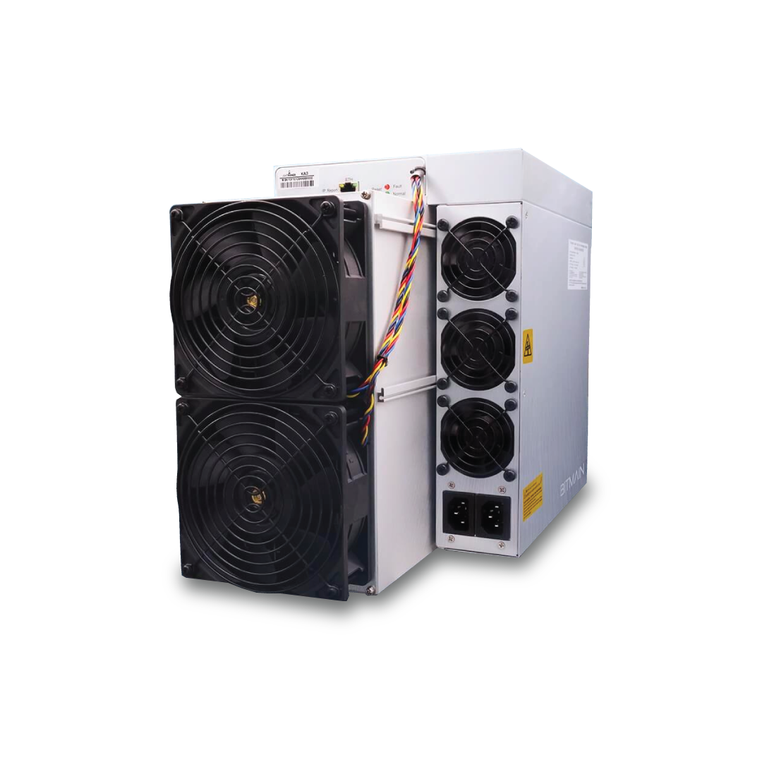


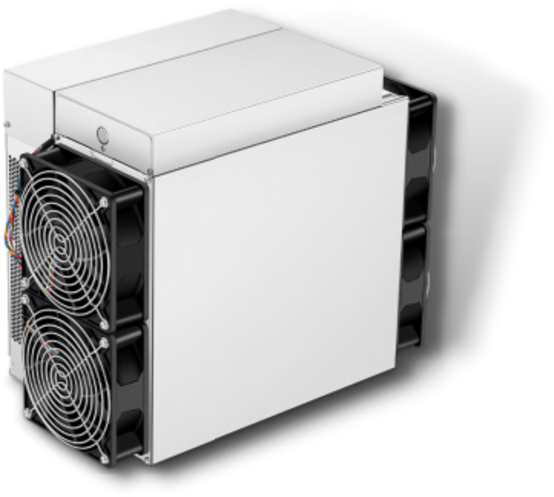

3080
Watt
3010
Watt
63.5
TH/s
140
TH/s
BITMAIN ANTMINER S19XP
BITMAIN ANTMINER K7
Bitmain are one of the top 5 ASIC manufacturers in the world and for good reason. Their outstanding hardware provides some of the highest hashrate in the entire industry. The S19xp is no different, setting the highest benchmark for ASIC mining to date.
Model Antminer K7 (63.5Th) from Bitmain mining Eaglesong algorithm (Nervos) with a maximum hashrate of 63.5Th/s for a power consumption of 3080W.
2-year extended CYCLESAFE™ replacement or repair warranty included (6 months manufacturer, 18 months reseller).

Slide 16

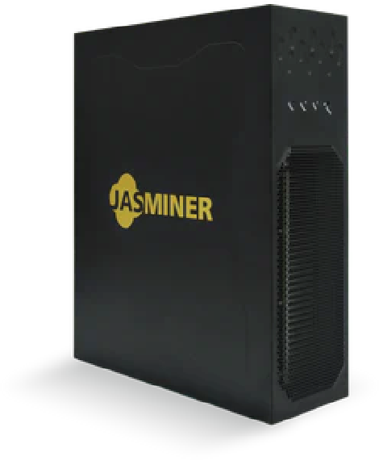
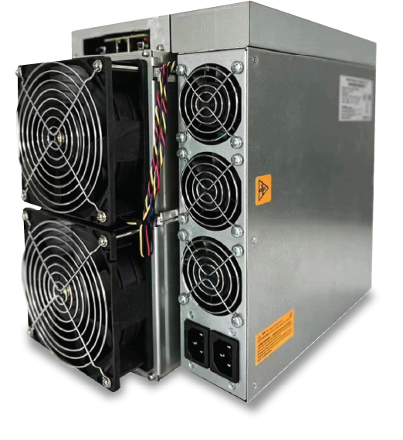
630
Watt
3154
Watt
166
TH/s
1,845
MH/s
Jasminer X16-Q Quiet (ETC)
BITMAIN ANTMINER KA3
The World’s first memory computing integrated high-trough put processor. Quiet, compact 3U rack-mountable format and rugged design.
Bitmain Antminer KA3 (166Th) mining the lucrative Kadena (Blake2s) algorithm with a maximum hashrate of 166Th/s for a power consumption of 3154W.
Now with Vipera’s CYCLESAFE™ PLUS 3-year extended warranty included. As with all mining hardware, we absorb all import duties (EU, NA, GCC only).

Slide 17
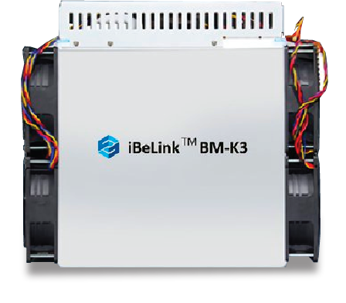
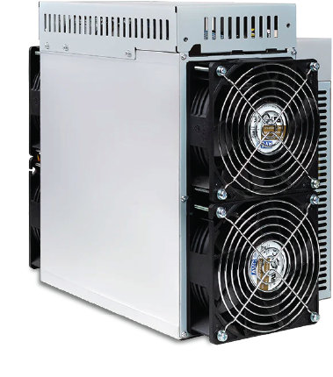
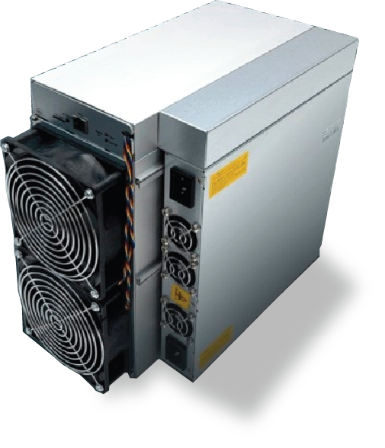
Blackminer L1
Model Blackminer L1 Mining Scrypt Algorithm with a maximum hashrate of 4.3Gh/s for a power consumption of 3450W. 1 year extended Vipera warranty included.
70
TH/s
25
TH/s
iBeLink BM-K3
iBeLink BM-N3
mines Kadena with a high hashrate of 70Th/s (+- 5%) for a power consumption of 3300W.
iBeLink BM3, released in 2022, is one of most power Kadena Miner of the year.
The efficient N3 has a 25Th/s hashrate performance coupled with a 3300W power consumption.
The BM-N3 is covered by a 6-month manufacturer warranty.
4,900 MH/s

Slide 18
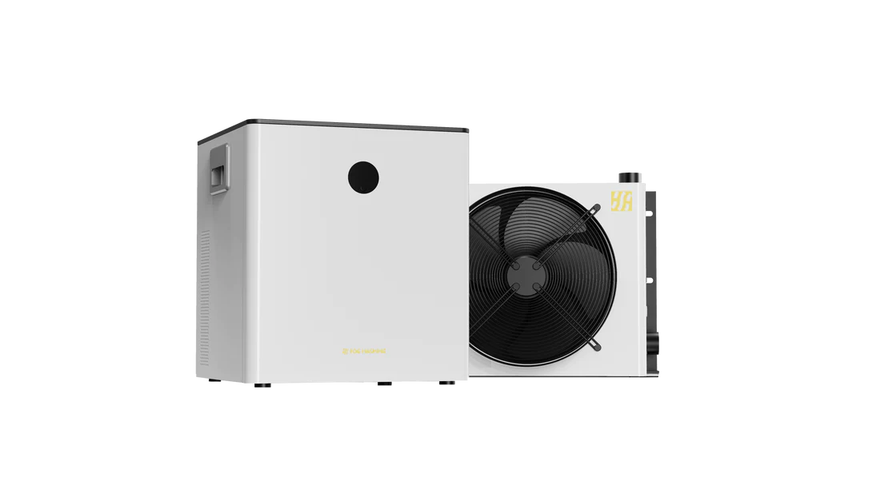
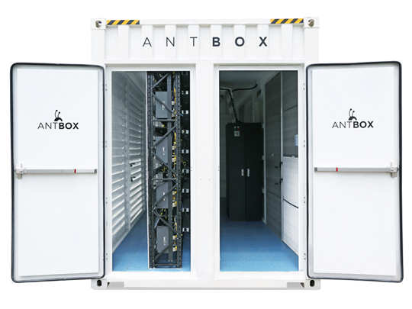
658KW
20
HQ
Bitmain Antbox N5 Mobile Mining Container Outdoor V2
FogHashing C1 Immersion Cooling Kit
For professional small to mid-scale mining operations.
A more efficient and economical solution that allows you to overclock and extract the most hashing performance out of your ASICS.
2-year manufacturer parts warranty.
Large exhausts with inlet filter pads and excellent heat dissipation
Improved features over previous generation include security camera, augmented heat isolation, facial recognition terminal, lightweight materials and more
The N5 V2 model can accommodate 207 S19 model ASICs. It is exclusive to the S19/S17/T19 “double-stack” format of ASICs.

Slide 19


SMART HEALTH
INNOVATIVE SOLUTIONS FOR HEALTH CARE PROVIDERS AND BUSINESSES
VIPERA

Slide 20

SOLUTIONS TO HELP BUSINESSES HANDLE A NEW REALITY
We have researched, designed and tested signage products and partnered with leading manufacturers across the globe to bring you a suite of virus prevention technology,
Our dedication to providing digital information tools and materials that make our hotels, venues, shops, eateries, hospitals, malls, transit hubs, schools and communities safer and prosperous is tantamount.
Furthermore, we have put emphasis on speed of delivery and relaying utmost transparency in costs, no matter if an order is small or large. We see an opportunity to use this challenging time to nurture lasting relationships with our clients.

Slide 21

BUSINESSES AFFECTED BY GLOBAL PANDEMIC
Hotels
Small Businesses
Airlines
80% of hotel rooms were left vacant
due to the pandemic
30% of small businesses closed permanently
due to the pandemic
90% of airline staff were let go
due to the pandemic
Unaffected
10%
Staff Retained
10%
Occupied Rooms
20%
Temporarily Closed
30%
Permanently Closed
60%
Empty Rooms
80%
Staff Let Go
90%
20
Bijou Solutions, Inc. | 2020

Slide 22
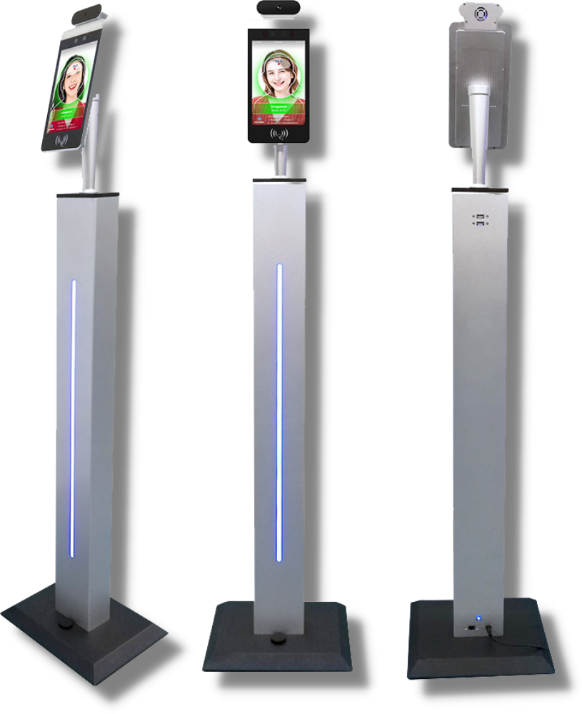

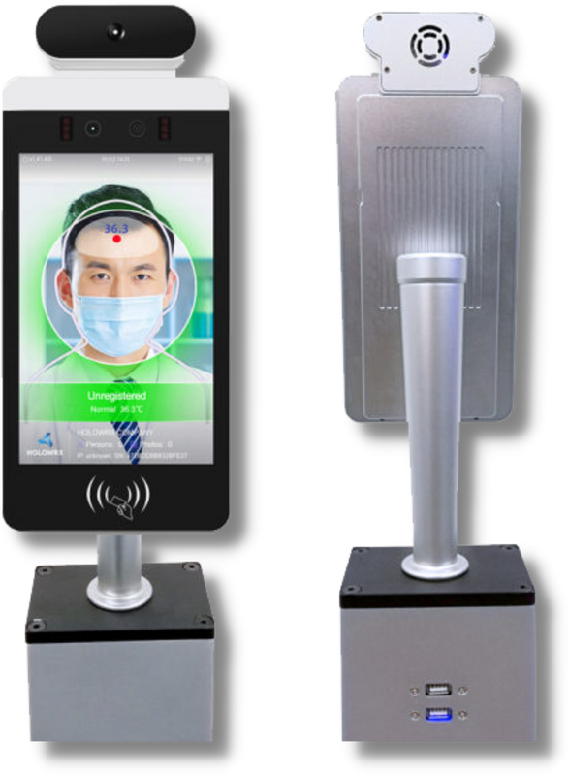
Viperatron VaxiPass
Since the outbreak of the new coronavirus in 2019, body temperature detection has become a necessary means to identify and prevent viral infections. Handheld infrared thermometers require short distances between humans, slow speeds, no record verification and require a large number of staff.
Using the face recognition temperature measurement access control, this device can save labor costs, reduce needless contact, and avoid cross-infection. It replaces fingerprint attendance check-ins. Allowing a smooth transition back to work and business.

Slide 23
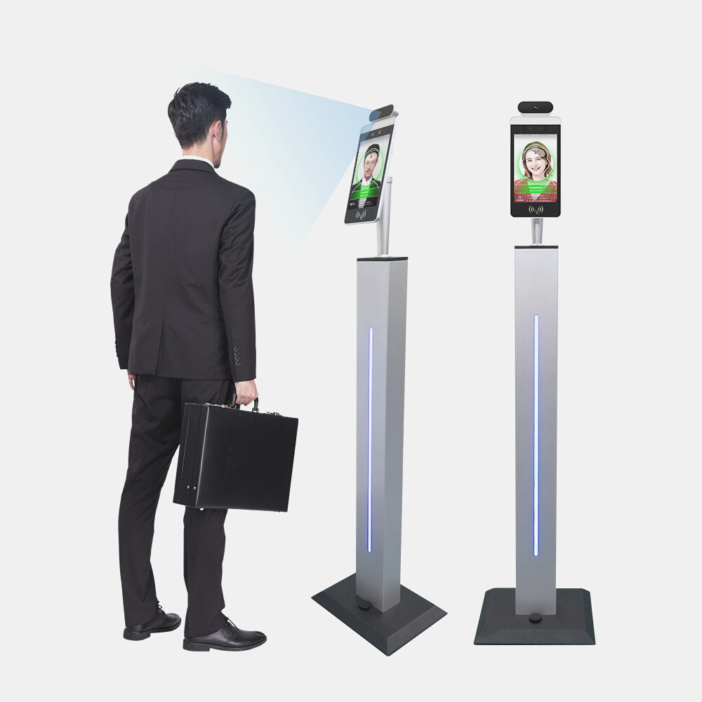
Viperatron VaxiPass
Introducing
A compact and modifiable detection solution adapted for hospitals, restaurants, offices, residential buildings, retail and more. Comes equipped with standard robust facial detection solution for optional controlled access to doors, gates and turnstiles.

Slide 24

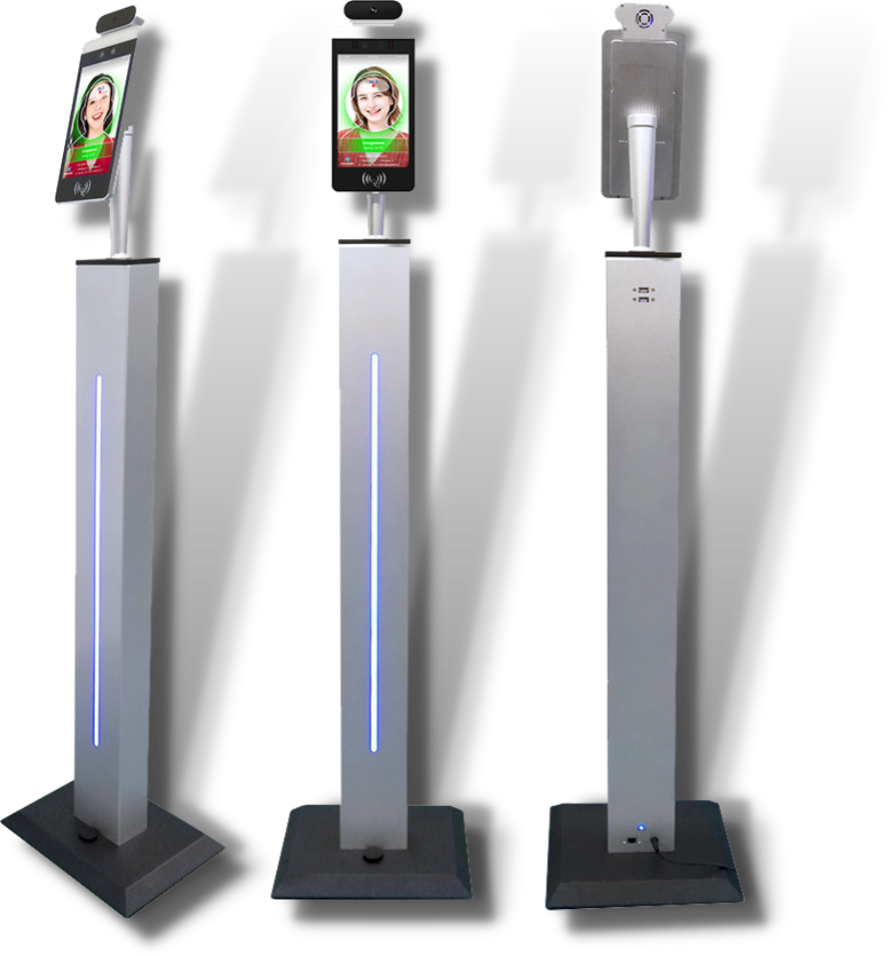
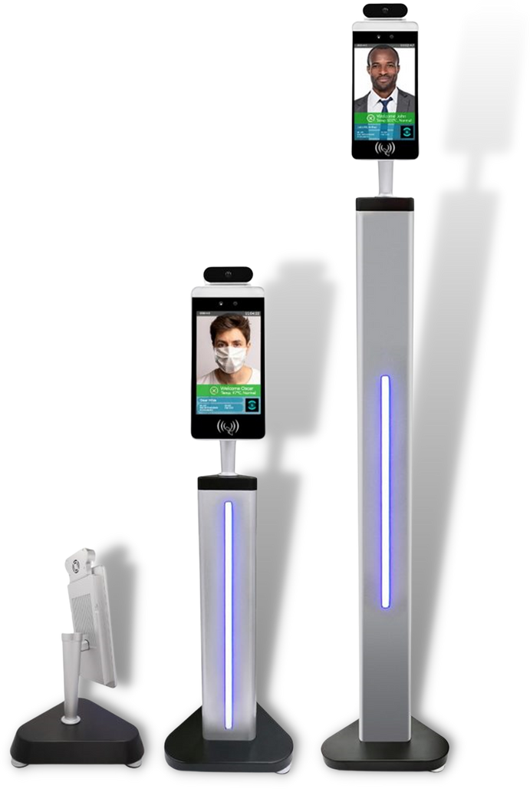
BUSINESS SOLUTIONS
Using Innovative Technology to Bring Businesses Back
Vaccine Certificate reader and identifier. Works with Vaccine Certificates from all over the world. Touch-screen kiosk automatically reads body temperature in seconds, with optional facial recognition and optional sanitizer dispenser solution.
Viperatron Vaxipass kiosk range is designed to provide an effortless safe environment for your employees, customers and visitors.

Slide 25
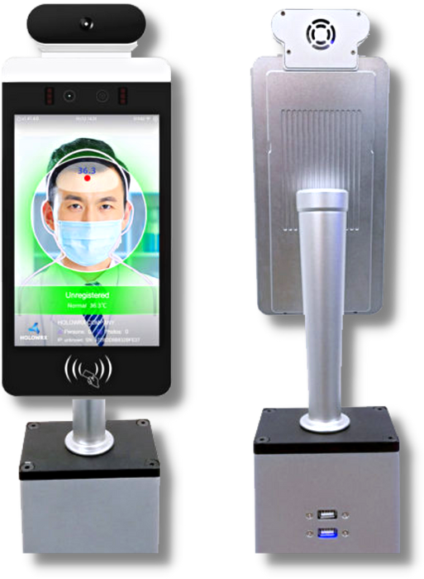
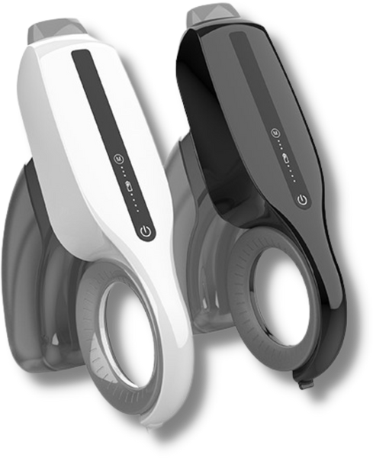
RONDO DISINFECTANT
FOGGER
VIPERATRON VAXIPASS
The worlds first dynamic thermometer kiosk, vaccine certificate authenticator, QR code reader designed to provide an effortless safe environment for your employees, customers and visitors.
Hand-held rechargable spray gun built to safely disinfect and sanitize surfaces at a distance with atomization technology.

Slide 26

DIGITAL SIGNAGE
PIONEERING A NEW ADVERTISING FUTURE
VIPERA

Slide 27
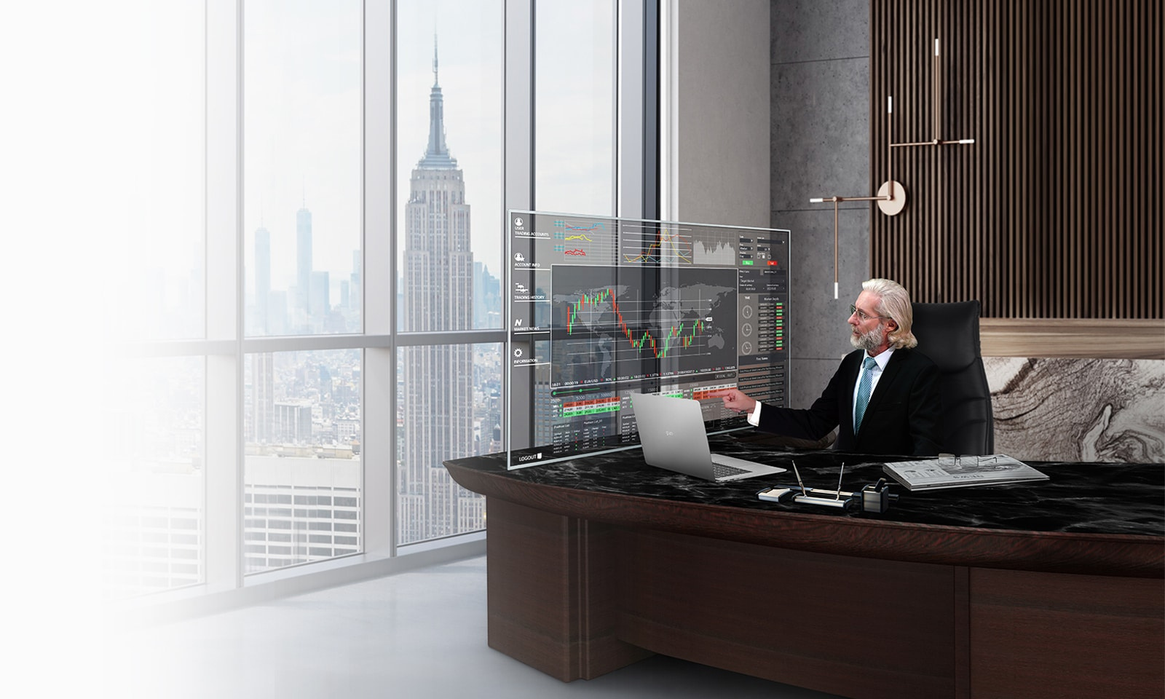

INNOVATION BUILT TO IMPRESS
Our select range of LG commercial displays are especially sought-after by customers looking to make a lasting impact with their brand and message.
LG's newest display lineup will completely transform your business and allow you to experience a level of creativity through unmatched innovation.
LG has revolutionized the way you can carry out your message, and Vipera has chosen them exclusively as for all OLED and signage projects.
VIPERA IS AN AUTHORIZED RESELLER OF LG BUSINESS SOLUTIONS, CURRENTLY THE EXCLUSIVE MANUFACTURER OF TOLED TECHNOLOGY.

Slide 28
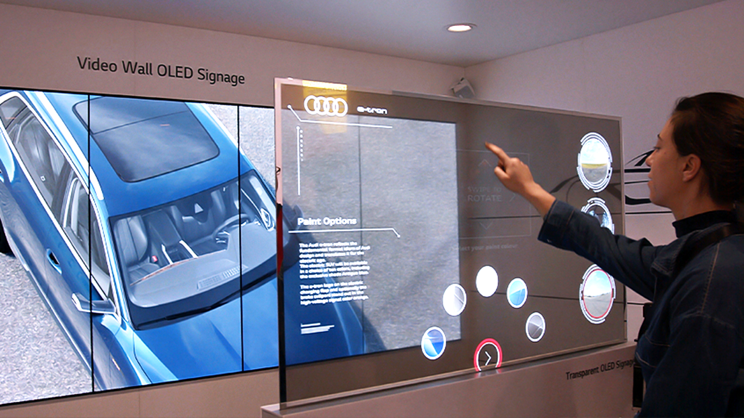
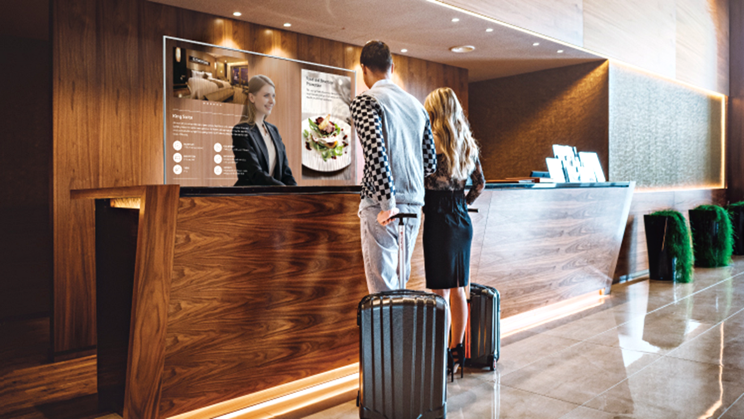
YOUR AUDIENCE
IS OUR WORKSHOP
Our fundamental belief is that a distinct initial consumer experience yields better business results. Many companies have recently risen to preeminence specifically because of their ability to deploy a coherent and meticulously crafted user experience.
Our work with agencies and brands always leads to dramatic results, rooted in a methodical transformation of ever-changing consumer expectations of media.
We craft transformative visuals using unorthodox methods that simply stand out against the rest. Where other agencies may quantify differences between marketing disciplines, we see them unified in our goal of creating a resonant, lasting experience.

Slide 29
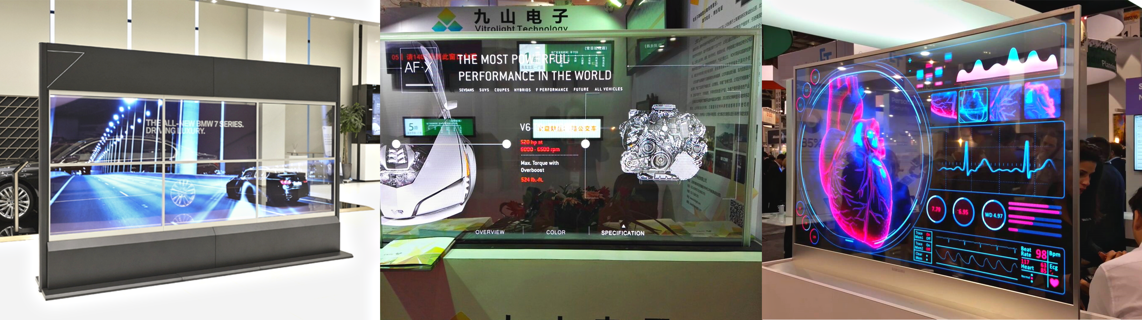
TRANSPARENT OLED
Boasting vivid and clear colors with high transparency, this technology provides valuable information about as well as visual enhancements to objects placed behind it, giving viewers an impressive, layered experience.
A slim, new technology developed by LG which makes it possible to achieve transparency without the need for any backlight enclosure. LG Transparent OLED signage illuminates spaces that once were hidden away behind the display, completely harmonizing with its surroundings.
Panels are designed semi-assembled, meaning you can install it in various ways to fit into existing structures and spaces. Displays can be also tiled together to make a immersive screen, enabling installation on large show-windows.

Slide 30

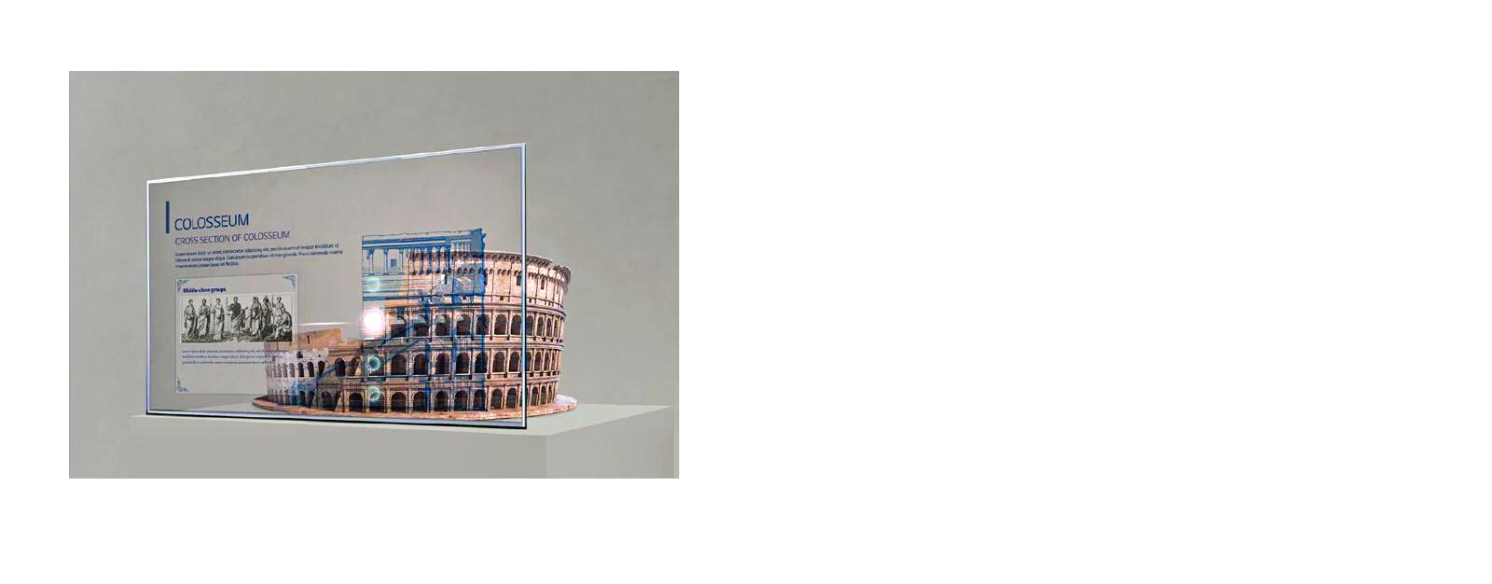
High Transparency
LG’s OLED technology makes the Transparent OLED Signage have slimmer structure without backlight unit nor a liquid crystal layer, achieving high transparency of 38% much higher than conventional LCD transparent displays (10%*). While clearly showing objects behind the screen, it overlays the relevant information right before them.
Accurate and Vivid Colors
Featuring self-lighting pixels, the display maintains vivid colors and high contrast ratio even when the display becomes transparent. It brings content to life from wide viewing angles, and the content blends into its surroundings seamlessly and naturally.
A New Level of See-Through
LG Transparent OLED signage illuminates spaces that once were hidden away behind the display,
completely harmonizing with its surroundings. Boasting vivid and clear colors with high transparency, this display provides visual enhancements to objects placed behind it, giving viewers an impressive "wow" factor.

Slide 31
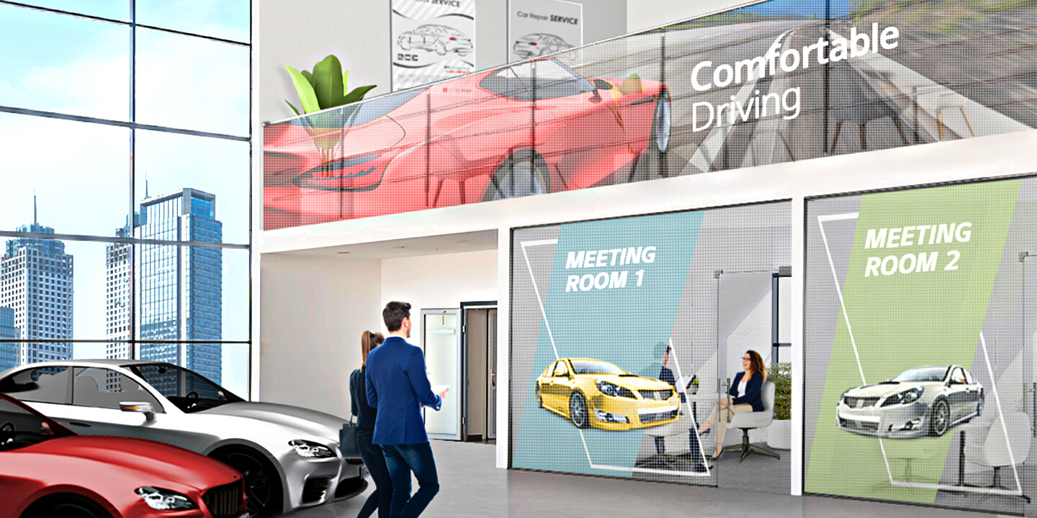
TRANSPARENT
LED FILM

Slide 32
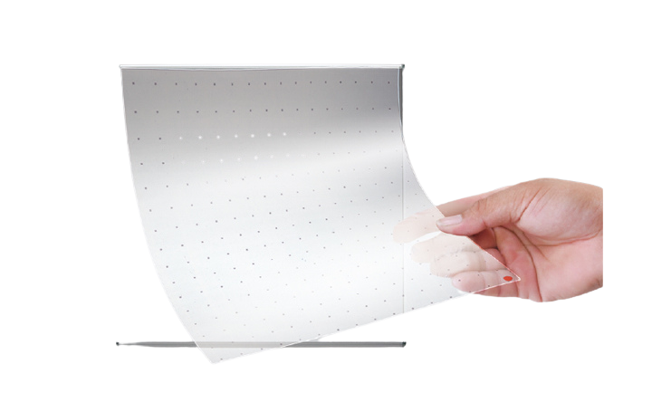
TRANSPARENT
LED FILM
SUPERB TRANSPARENCY
The LG Transparent LED film reflects the object behind the product even after the product is attached and turned off. This offers a wide-open view while blending into existing interior design smoothly and delivers various information effectively by attracting the attention of passersby.
SELF-ADHESIVE FILM
The LG Transparent LED film is self-adhesive, so it can be easily attached to the surfaces of existing window glass without the need for any complicated construction.
OUTSTANDING EXPANDABILITY AND FLEXIBILITY
The size and layout of the film can be customized to fit into the installation area. It can be expanded by adding more films in a vertical or horizontal way, or cut in parallel with the bezel to meet size requirements.
FITTING IN WITH FLATS AND CURVES
The LG Transparent LED film supports curvatures up to 2,000R convex and concave for curved glass or window applications, and offers even surface by durable, transparent layers. This allows a wide range of venues to be redesigned with the LAT series as a landmark.

Slide 39
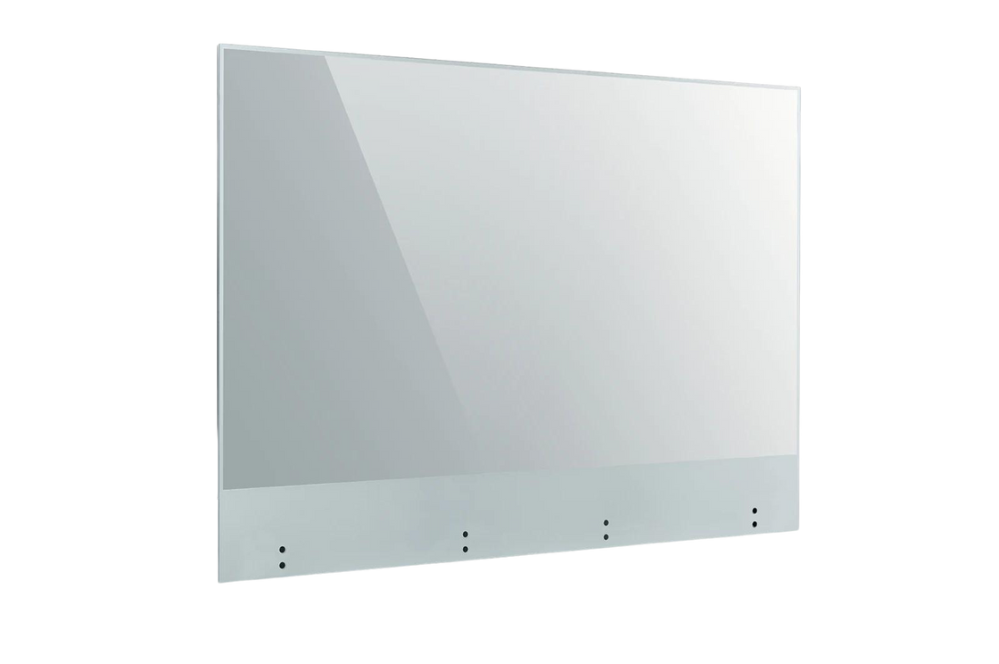
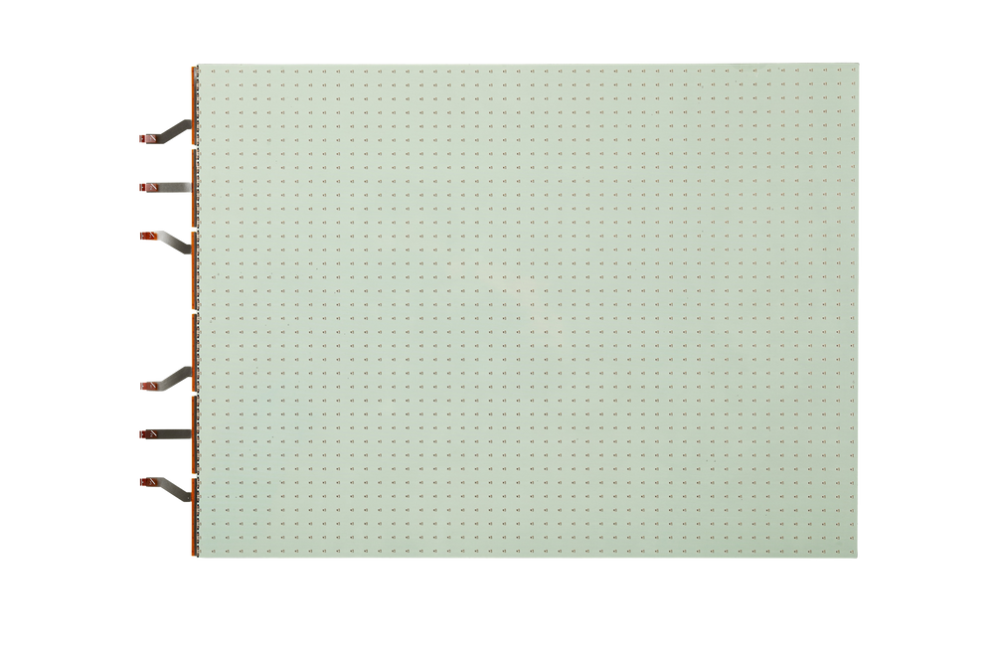
TRANSPARENT OLED
TRANSPARENT LED FILM
LG Transparent OLED Touch Signage illuminates spaces that once were hidden away behind the display, completely harmonizing with its surroundings. It can respond according to viewers touch, which has great potential for various applications where customer interactions are required.
The LG Transparent LED film reflects the object behind the product even after the product is attached and turned off. This offers a wide-open view while blending into existing interior design smoothly and delivers various information effectively by attracting the attention of passersby.

Slide 40

PROFESSIONAL GRADE HARDWARE WITH A DIFFERENCE
PC GAMING
VIPERA

Slide 41

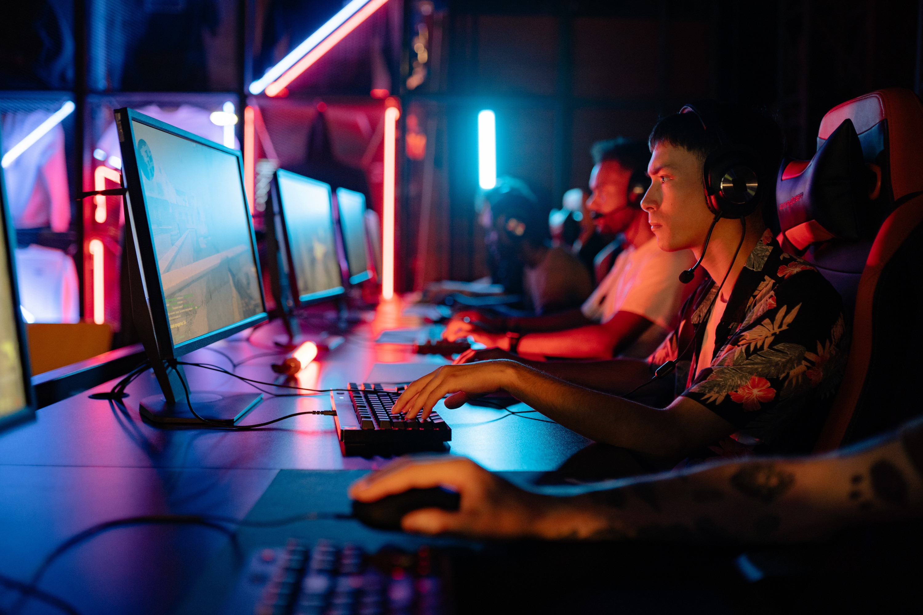
UNRIVALED EXPERTISE
Due to the significant rise in Esports and PC gaming over the last few years there has been an ever-growing demand for custom built PC's that allow gamers to perform at a professional level without any delays.
With gaming set to increase at an even faster pace than before, its imperative that gamers stay on top of the latest technologies.
Therefore, we have made it our goal in becoming one of the worlds leading custom PC building companies by 2023. Together, with the help of our outstanding team of professionals, we continue to craft, design and build award-winning, world-class computers.

Slide 42
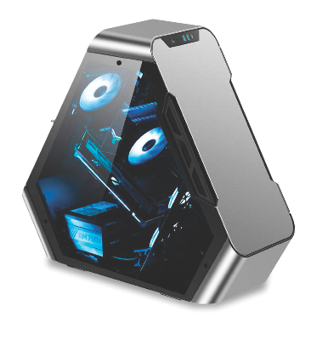
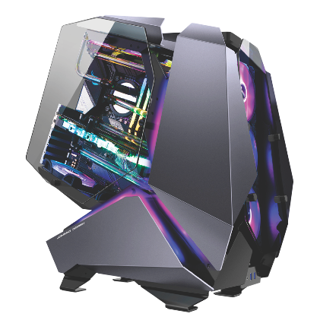
EXETON PARAGON
EXETON AGGRESSOR
Thermaltake Core P3 Glass
Asus Rog Strix Crosshair Hero X670E
AMD 7950X
MSI Suprim X 4080 or Asus Rog Strix 4080 (+$500 AED)
Corsair MP600 2TB
Samsung 870 QVO 4TB
Asus Rog Strix 850G
Lian-Li 1x 24 pin and 2x 8 pin Strimer RGB
Corsair XH303i Liquid Cooling Custom Loop
Corsair Vengeance DDR5 64GB 5200mhz

Slide 43
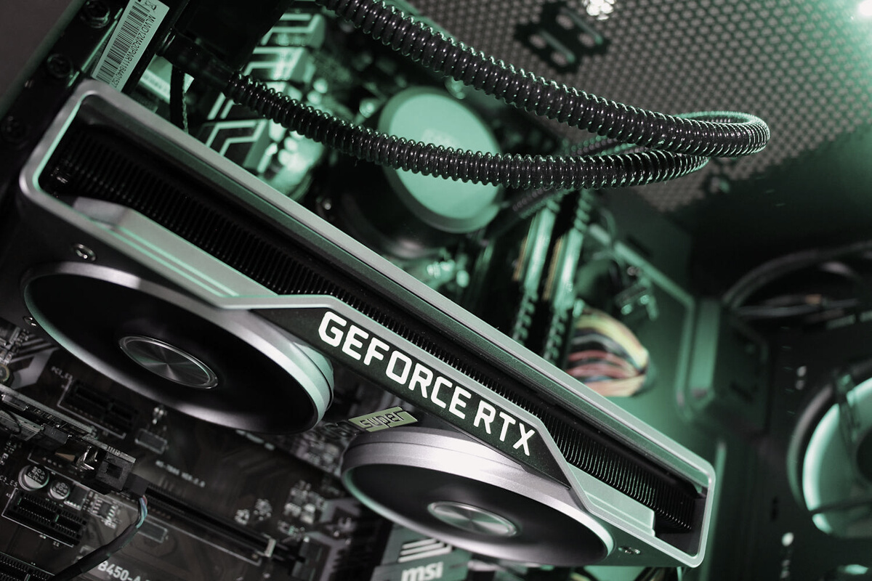
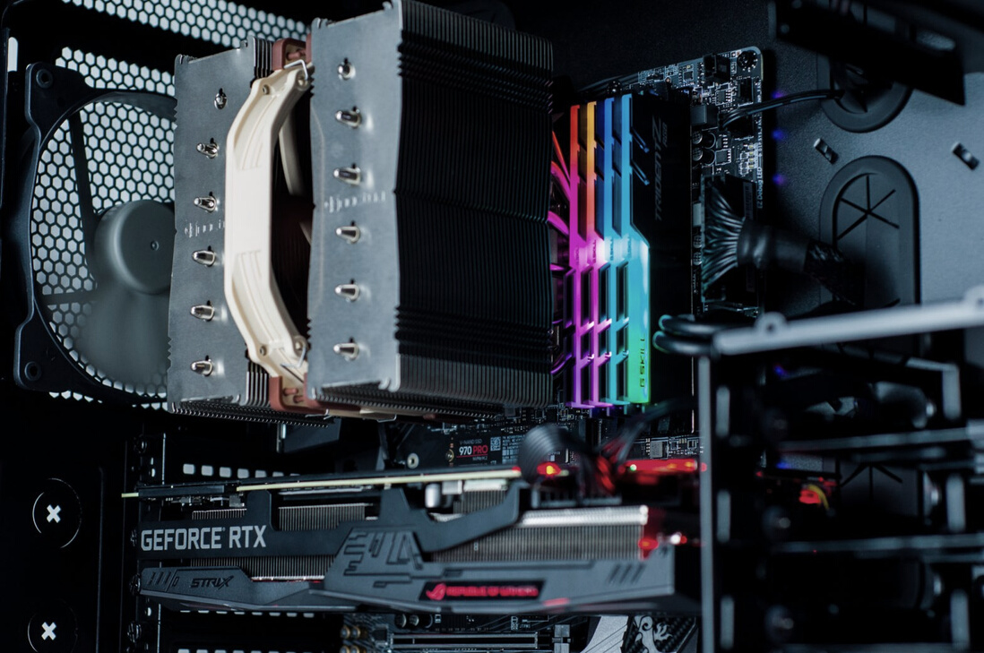
WORLD CLASS
We build custom PC's tailored for gaming
with performance at the forefront and expertise at its core.
CUSTOM BUILT
With over a decade of experience in building the world’s most advanced custom gaming computers we have the edge you need to be the best.
GROUNDBREAKING
With a focus on every element, we ensure no stone is left unturned when it comes to squeezing out every ounce of power available.

Slide 44
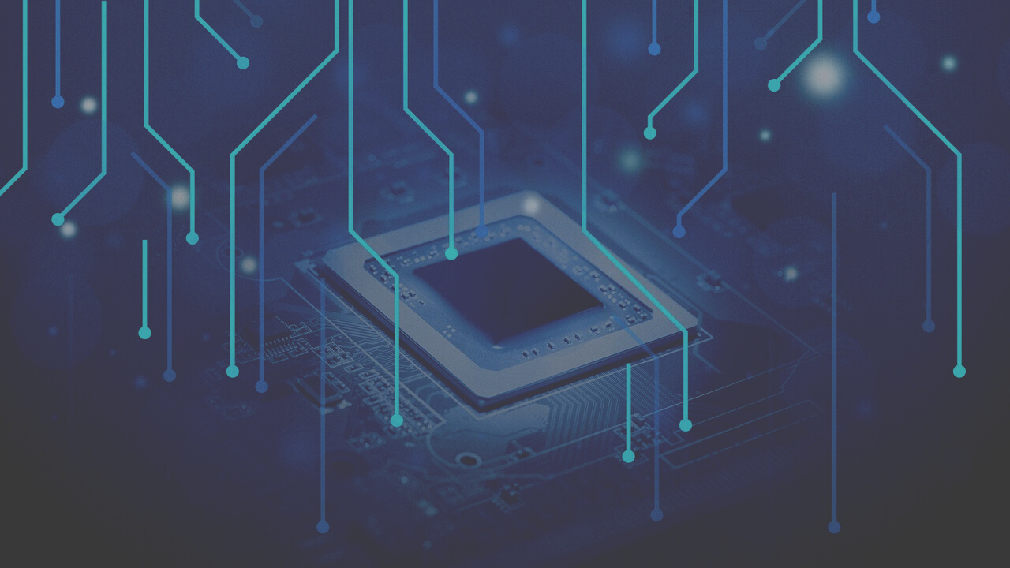


DOLLARS SPENT ON GAMING INDUSTRY 2022
200
Billion Dollars USD
PROJECTED TO INCREASE TO 268 BILLION (USD) BY 2025
Meyer & Parks Realty 2020

Slide 45
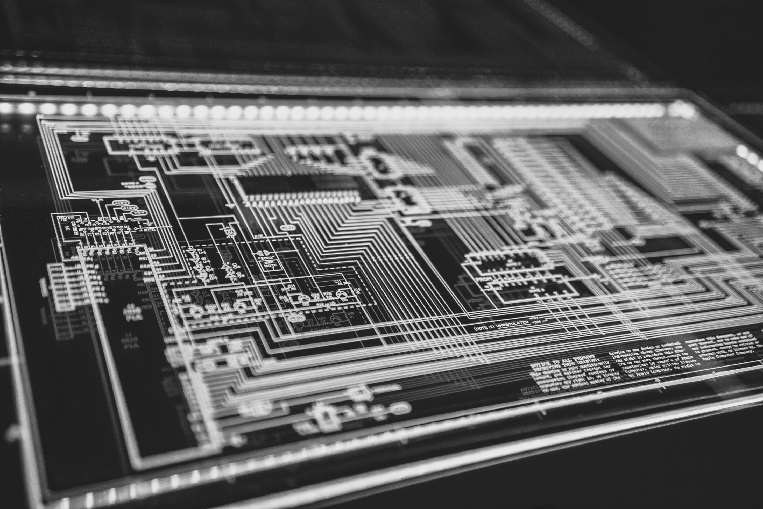
NEXT-GEN HARDWARE
Experience a new level of performance with an award-winning PC. Built with the latest technology and highest quality components.
Competitive Edge
Our dedicated team tests every gaming computer with a series of stress-tests and benchmarks that analyze the processor, memory, graphics cards, storage, and even the power supply so that you can play with confidence.

Slide 46

NEXT GENERATION AUTOMATED SYSTEMS
A.I COMPUTING
VIPERA

Slide 47

Tomorrow's Technology Today
Artificial intelligence (AI), once the subject of people’s imaginations and main plot of science fiction movies for decades, is no longer a piece of fiction, but rather commonplace among people’s daily lives whether they realize it or not.
AI refers to the ability of a computer or machine to mimic the competencies of the human mind, which often learns from previous experiences to understand and respond to language, decisions, and problems.
These AI capabilities, such as computer vision and conversational interfaces, have become embedded throughout various industries’ standard business processes. The industries that have become prominent for AI adoption in organizations include high tech and telecommunications, financial services, and healthcare and pharmaceutical.

Slide 48

GLOBAL AI MARKET IN 2021
327
Billion Dollars USD

Slide 49

BREAKING BOUNDARIES
Our fully integrated AI platform enables a diverse portfolio of machine learning products and services across industries that work seamlessly together to create AI at scale.
No matter the task or workload, our integrated AI systems can help break boundaries.
We combine AI capabilities with world class technology to enable organizations to solve a broader set of challenges.

Slide 50
NO MOUNTAIN TO STEEP
Our AI systems can tackle any task wether its data collection, language processing, unstructured data analysis, speech recognition and much more.
By building some of the best AI protocols in the industry we help businesses and partners streamline their workflow to optimize efficiencies across their entire sector.
Day and night our engineers are busy designing one-of-a-kind optimal network topologies to surpass industry standards.
You might be looking for traditional AI systems or be in the market for custom designed models to do something extremely special, whatever it is you need, you can rest assured that we have you covered.

Slide 51
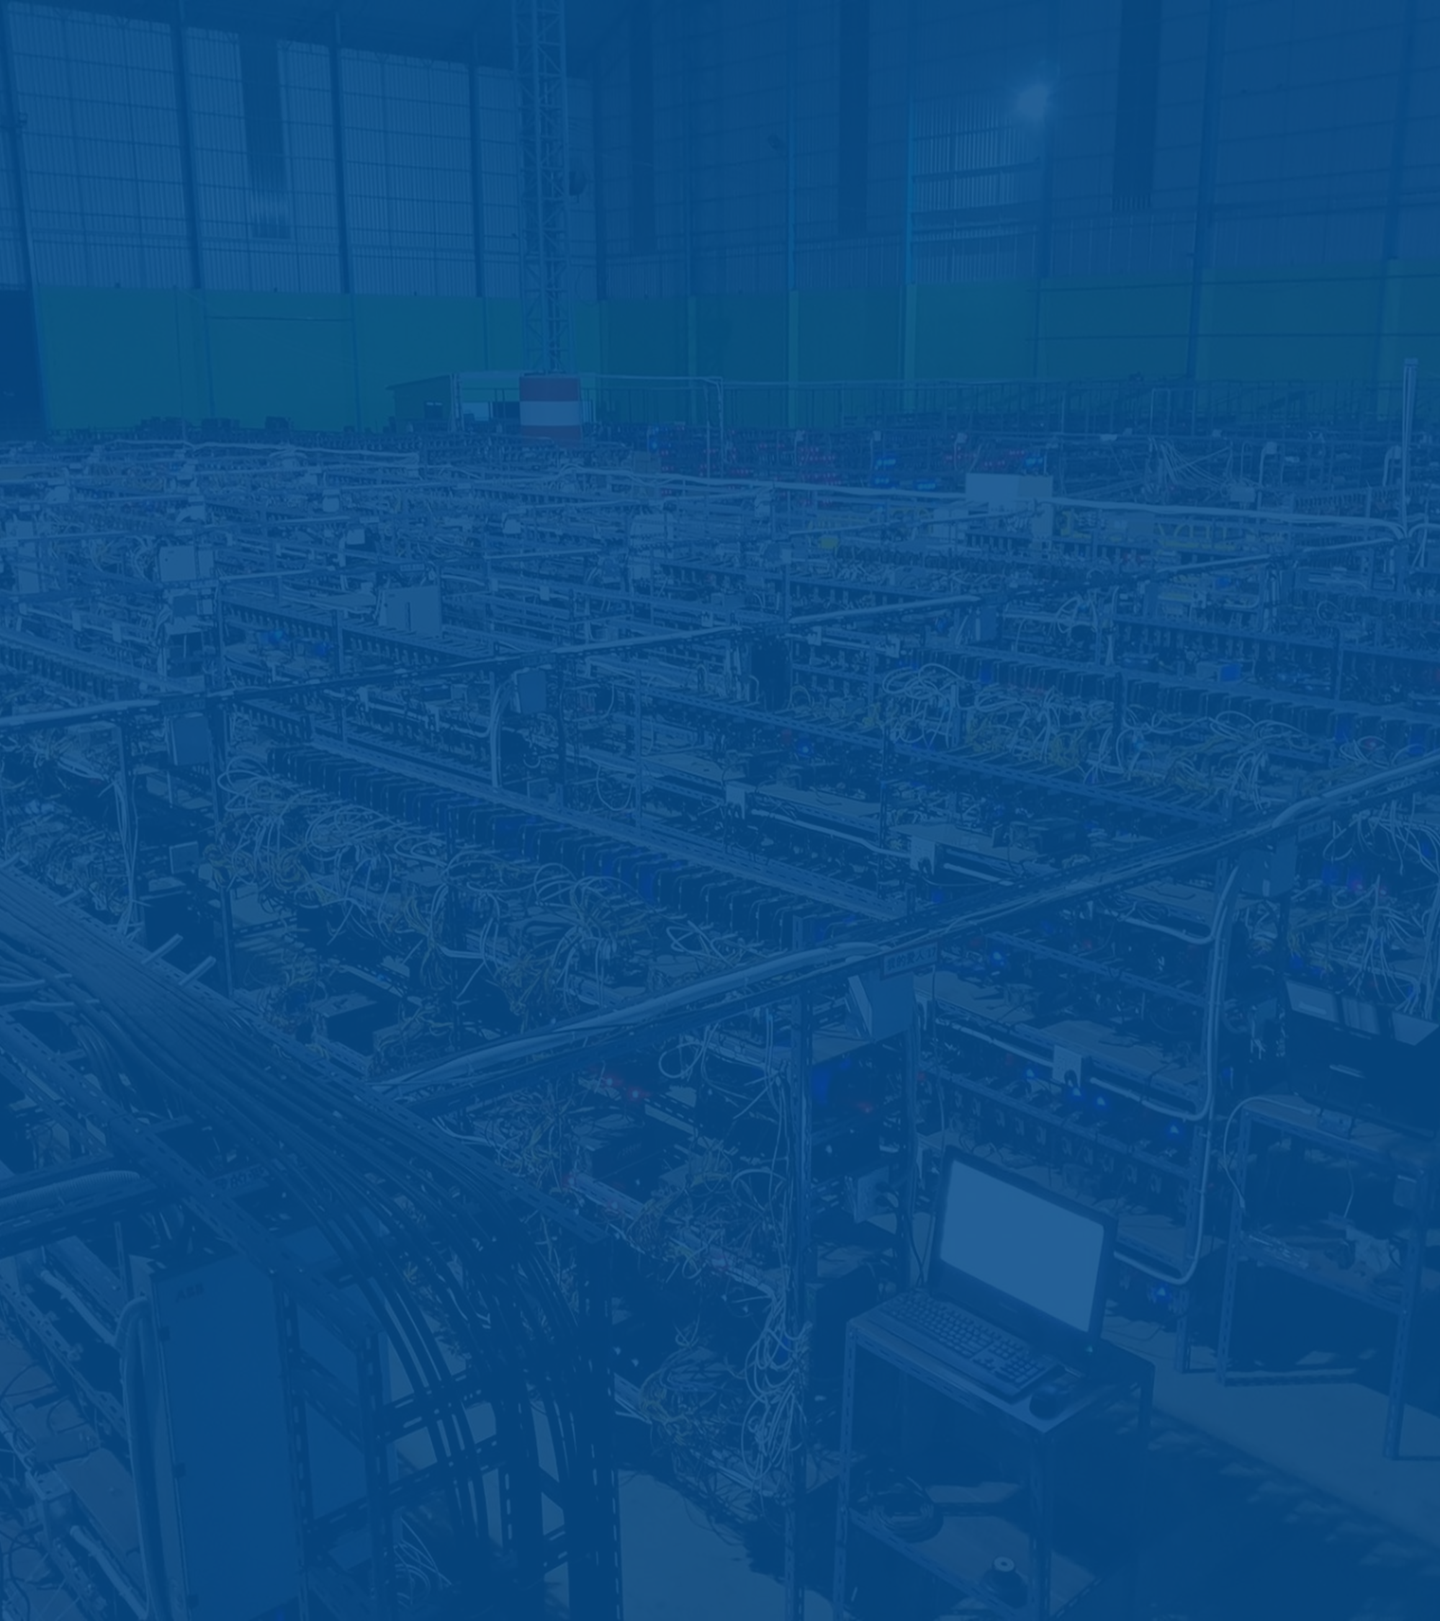
BE THE CHANGE, BE A CRYPTO PIONEER
MINING COLOCATION
VIPERA

Slide 52
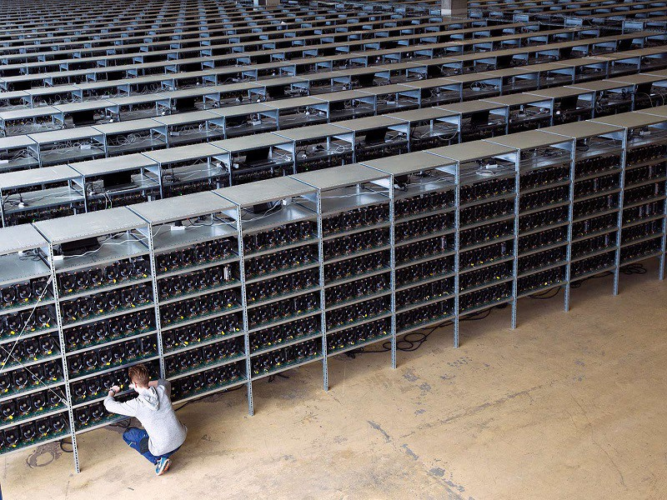
MINING, DESIGNED
BY MINERS
HAND IT OVER TO THE EXPERTS
Digital currencies are strengthened as trust is built by decentralised systems run by individuals around the world. We help push the movement forward with the world's best mining equipment, first-class technical support and clear communication. We have our customers in mind when we make decisions as we press on with the development of the cryptocurrency industry and bring along our dedicated customers in the process.

Slide 53
OUR DISTINCT ADVANTAGE
Since 2016, our dedicated team of experts have been developing and evolving a successful 500 unit mining farm in Montreal, Canada. Our work over the past 5 years has given us a deep understanding of the steps necessary in order to achieve consistent profits in the crypto mining industry and we pride ourselves on our ability to overcome the challenges involved.
Our data center facilities are built from the ground-up and are extremely energy-efficient.
Through our infrastructure portfolio, we can offer you operating conditions that allow you to run clusters with unparalleled efficiency and reliability.

Slide 54

OPERATIONAL MINING
GROWTH
2023+
Development
Execution
Results
We are always building new crypto mining facilities to add to our current portfolio.
Our facilities are always designed to operate at the highest standards as we combine our shared knowledge to implement truly groundbreaking opportunities.
No one does it better in the industry than our skilled technicians. With years of experience, our dedicated team will ensure the materials required to excel are implemented and maximum hashrates met.
We maintain consistent communication with our customers, providing a much-needed window into operations so that you can sit back and watch as your investment and profits grow.

Slide 55




GET IN TOUCH
We are committed to providing the best of the best
CANADA
1881 BOUL ST-REGIS
MONTREAL, QUEBEC
H9S 1Y3
U.A.E
11B Building, 6G
Happiness Street
City Walk, DUBAI
+1 514 594 8552
JAMES@VIPERATECH.COM
VIPERATECH.COM
JAMES CAMPAGNA
JAMES CAMPAGNA
ONLINE

